Slide 1
Introduction to
Anatomy and Physiology I

Slide 2
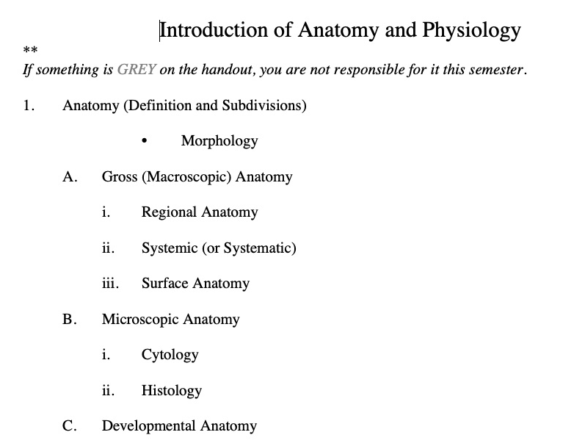

Slide 3
Regional Anatomy

Slide 4
Systems of the Body

Slide 5
Cytology:
study of cells

Slide 6
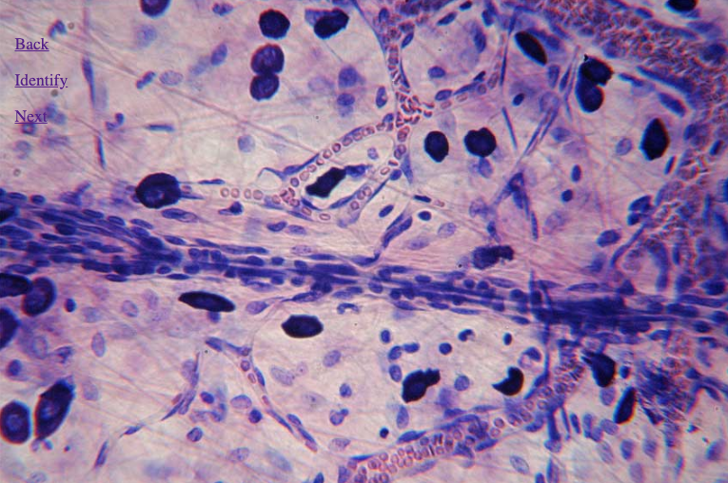
Histology

Slide 7
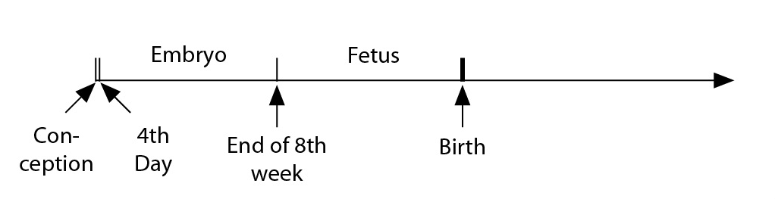
Developmental Anatomy

Slide 8
Pathological
Anatomy

Slide 9
Radiographic
Anatomy

Slide 10
Molecular Biology

Slide 12
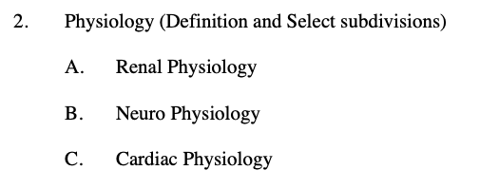

Slide 14
Life Processes

Slide 15
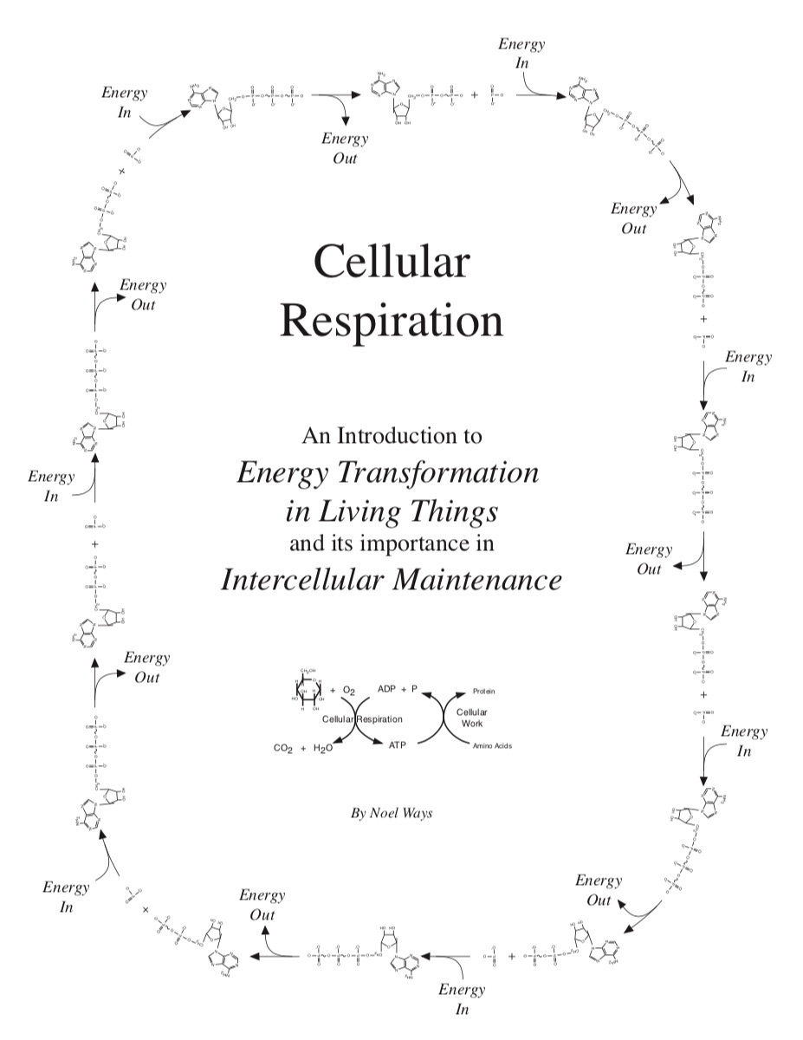
Have this Handout
Available

Slide 16
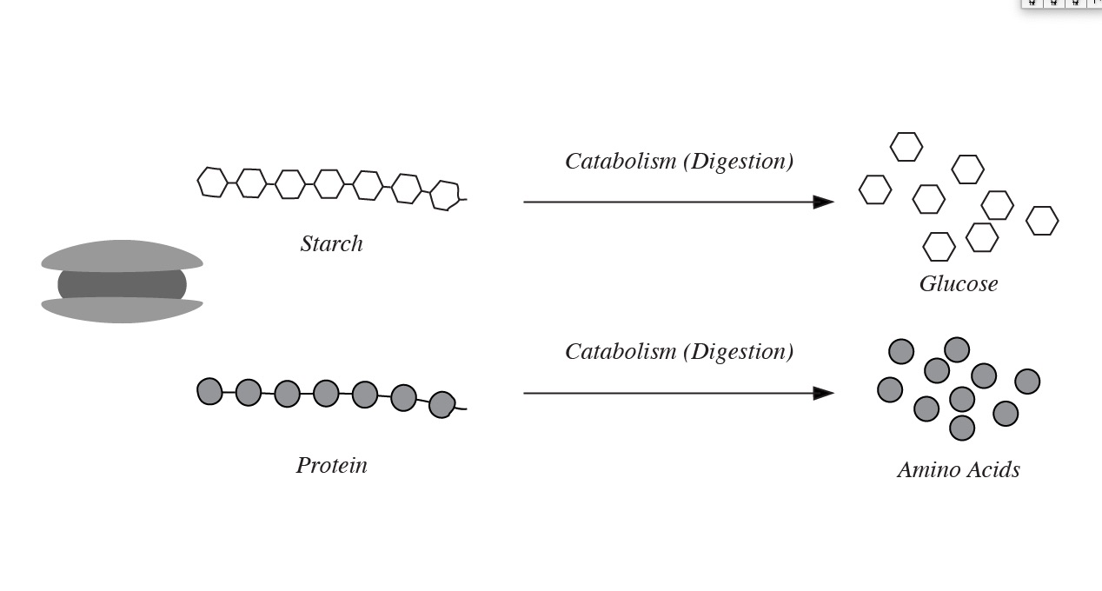

Slide 17
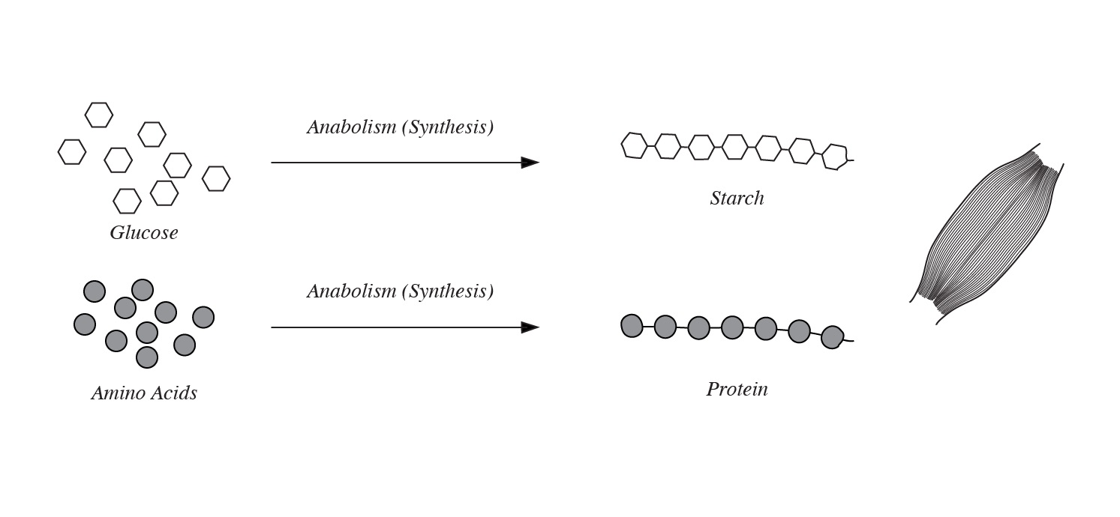

Slide 18
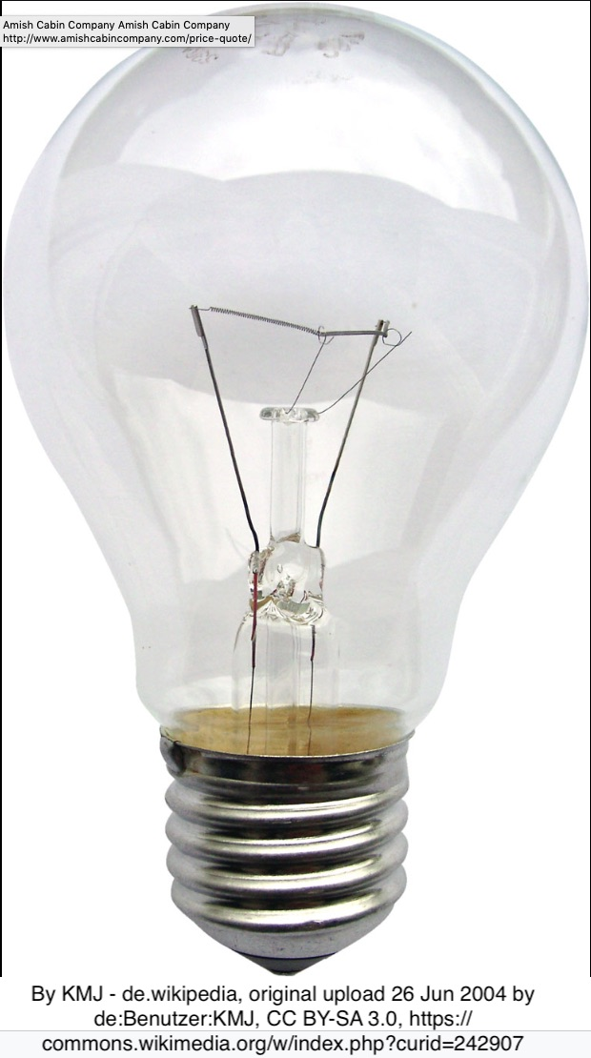

Slide 19
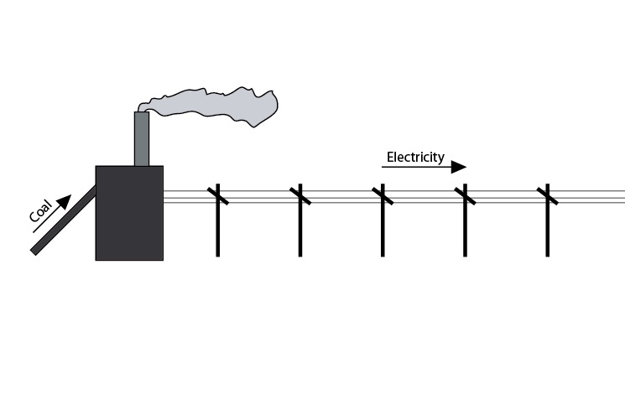

Slide 20
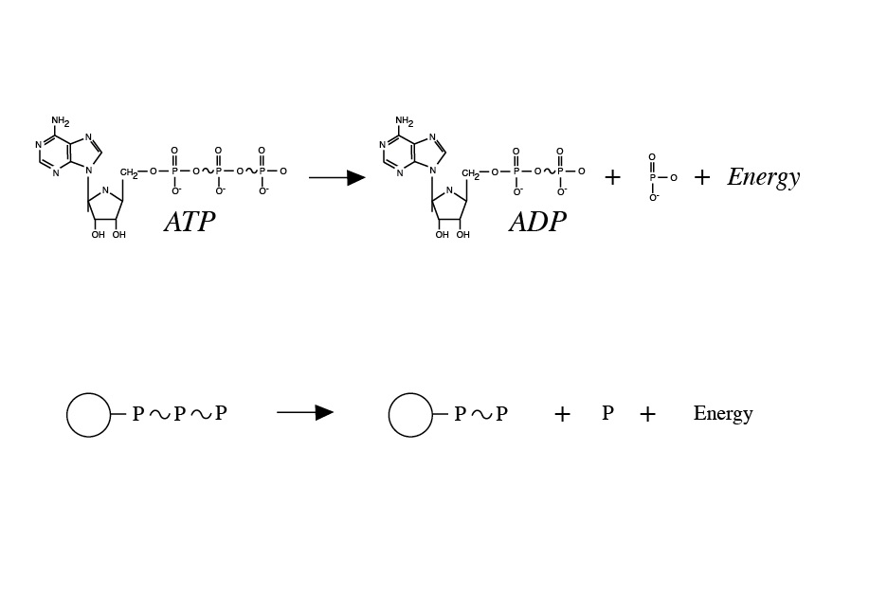

Slide 21
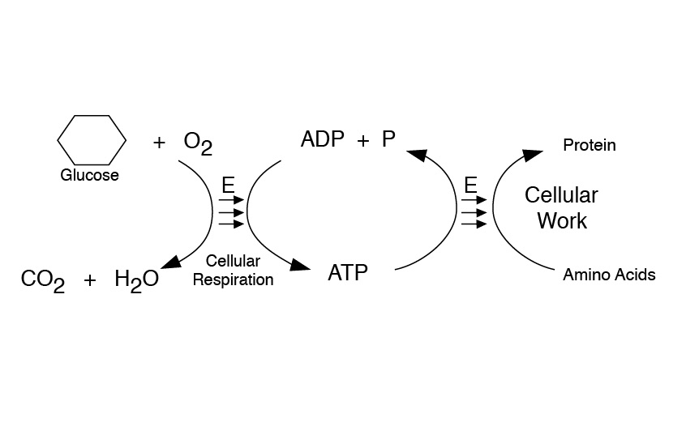

Slide 22
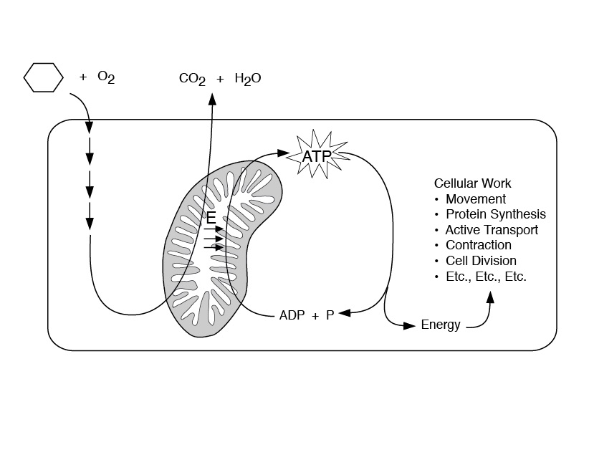

Slide 23
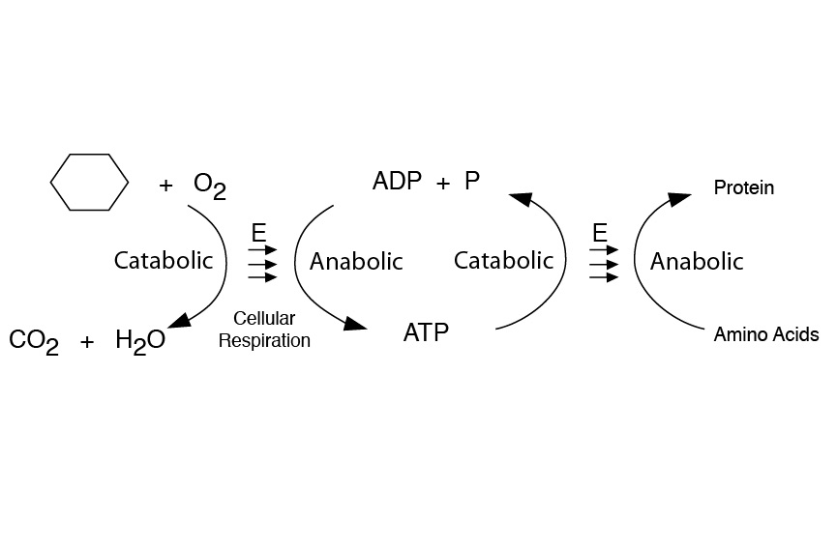

Slide 24
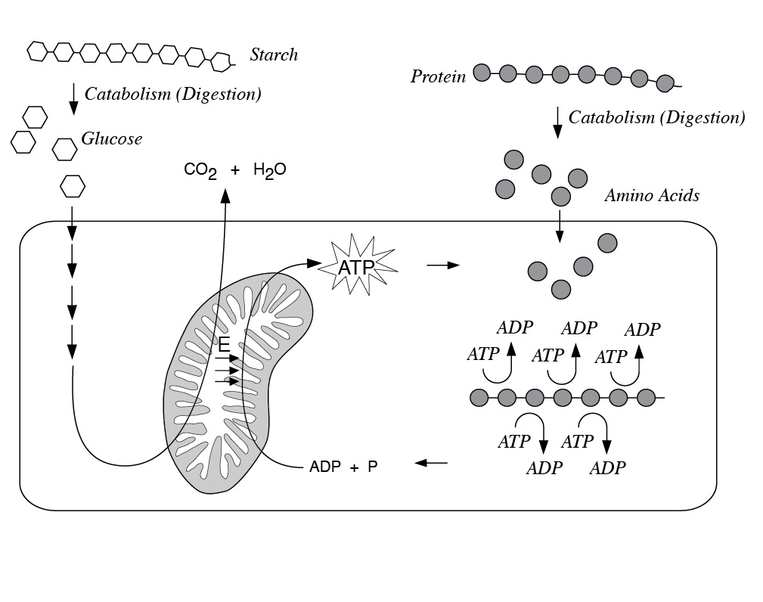

Slide 25
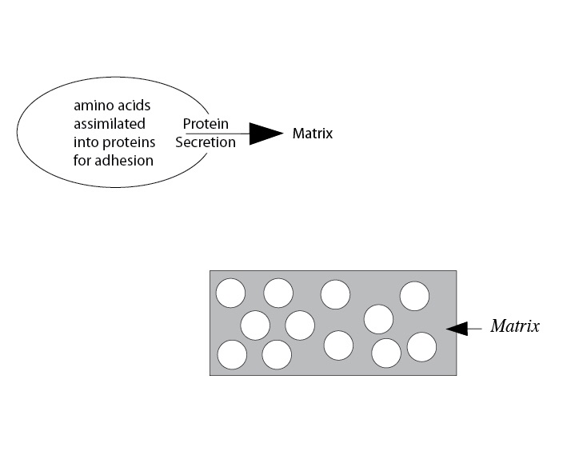

Slide 26
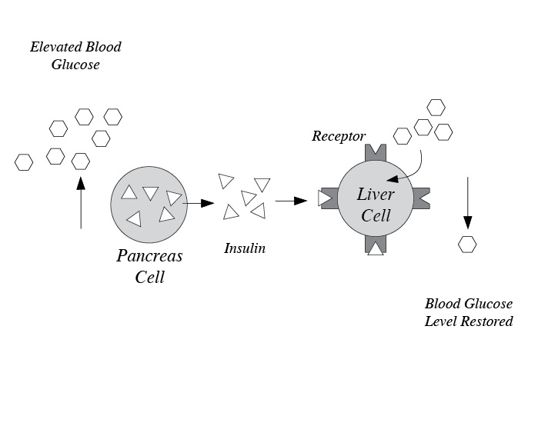

Slide 28
Life Processes: Remaining
Excitability through Reproduction
(Whiteboard)

Slide 30
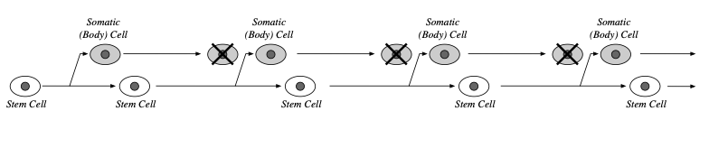

Slide 31
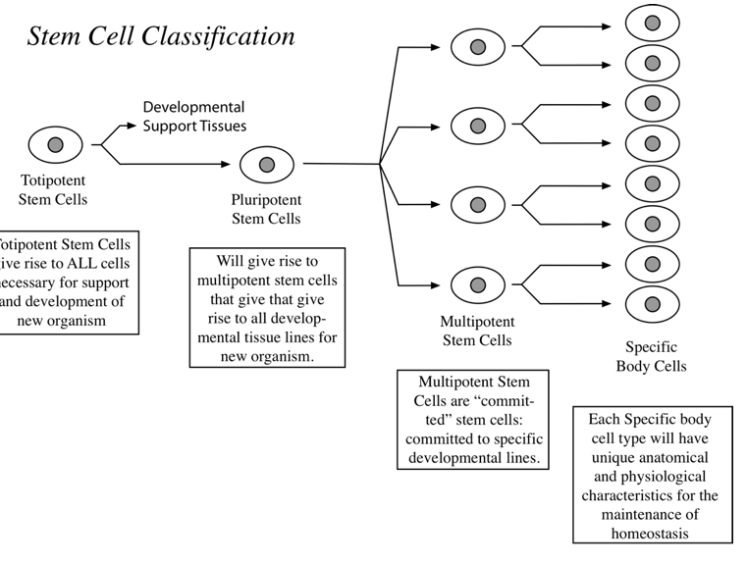

Slide 32
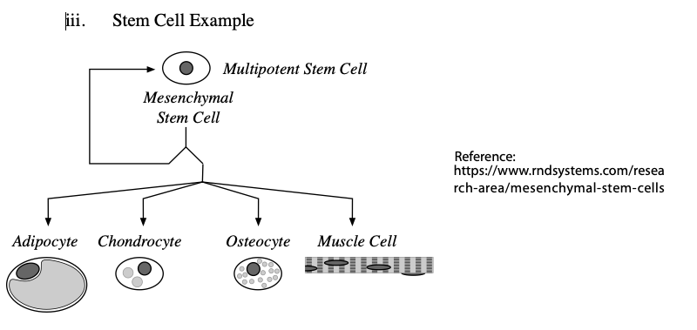

Slide 35
Levels of Structural Organization

Slide 36
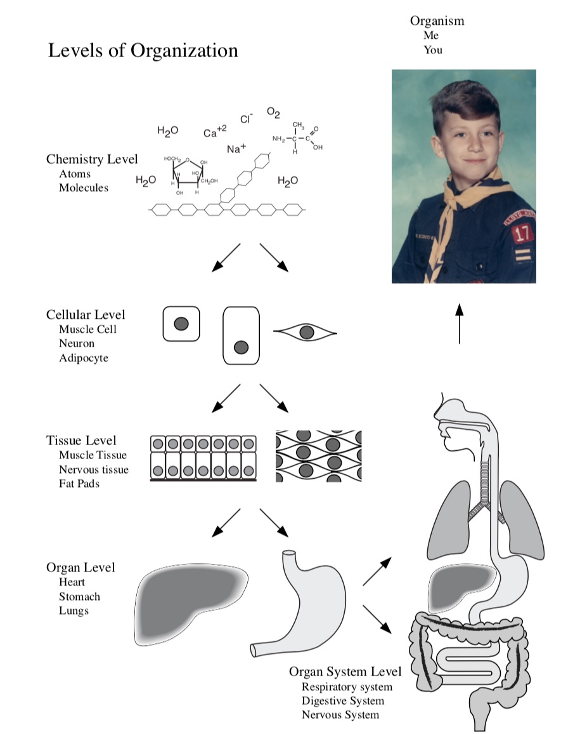

Slide 38
Fluids of the Body

Slide 39
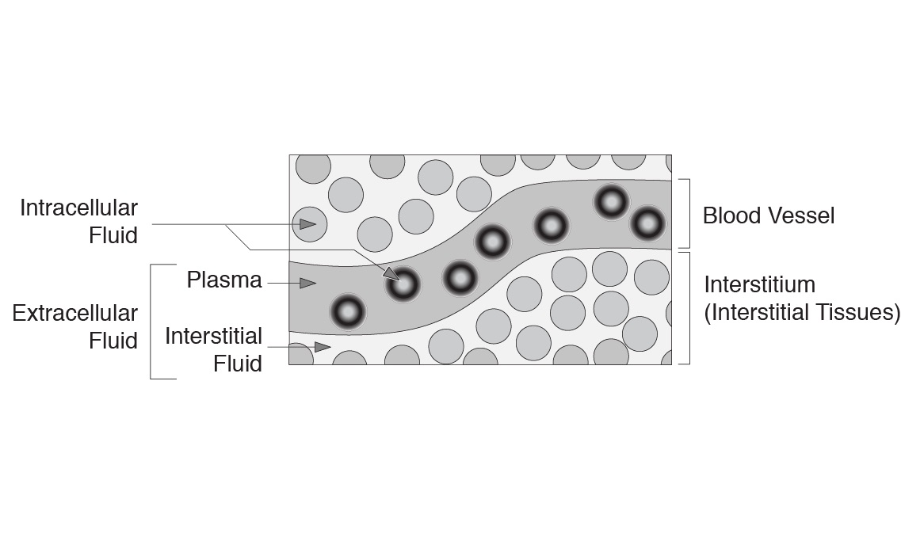

Slide 42
Homeostasis and Negative Feedback Mechanisms

Slide 43
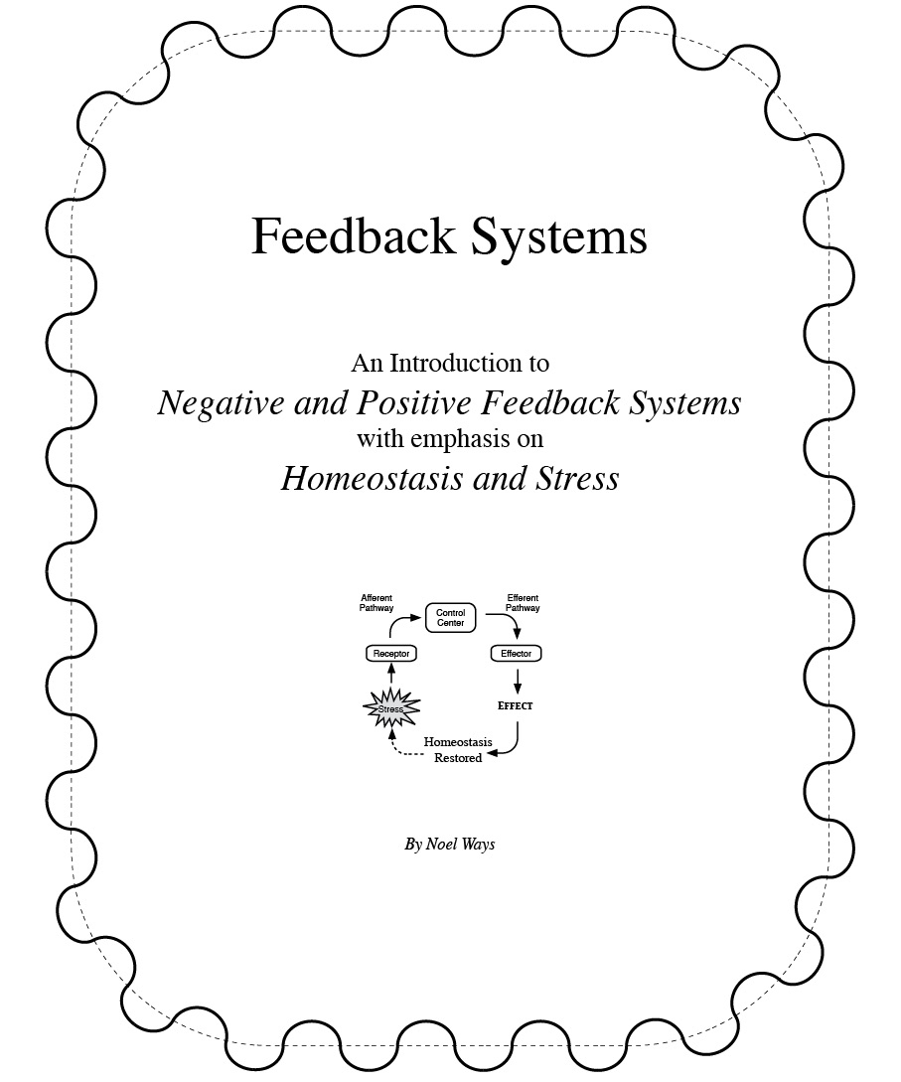

Slide 44
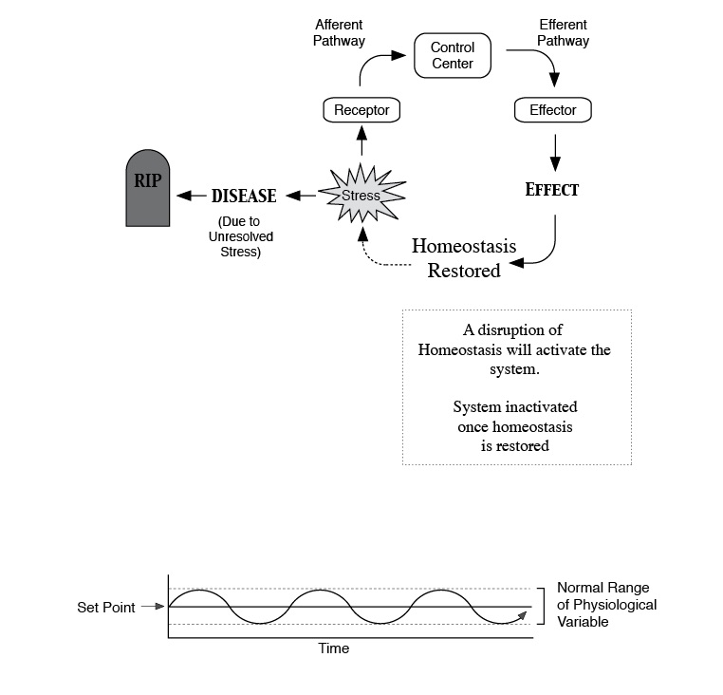

Slide 45
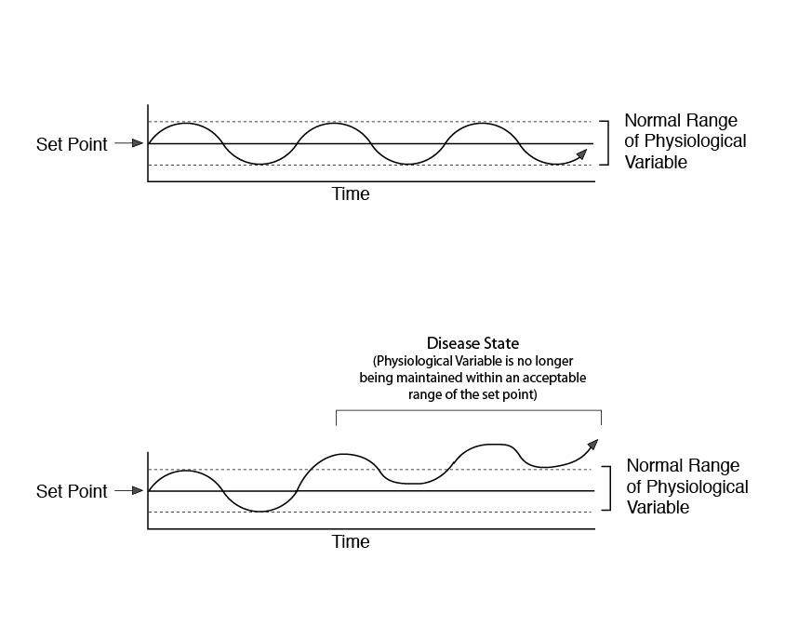

Slide 46
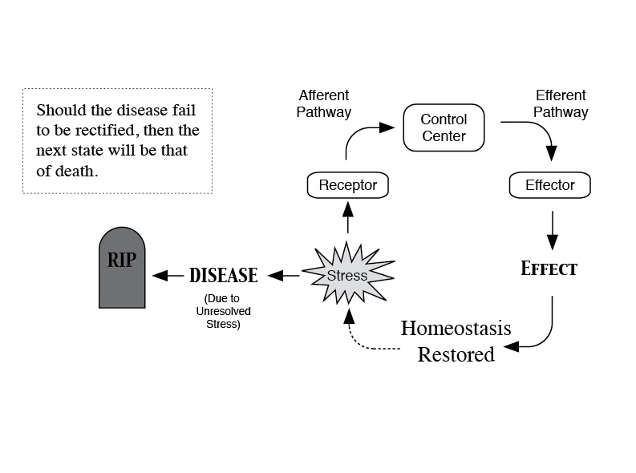

Slide 47
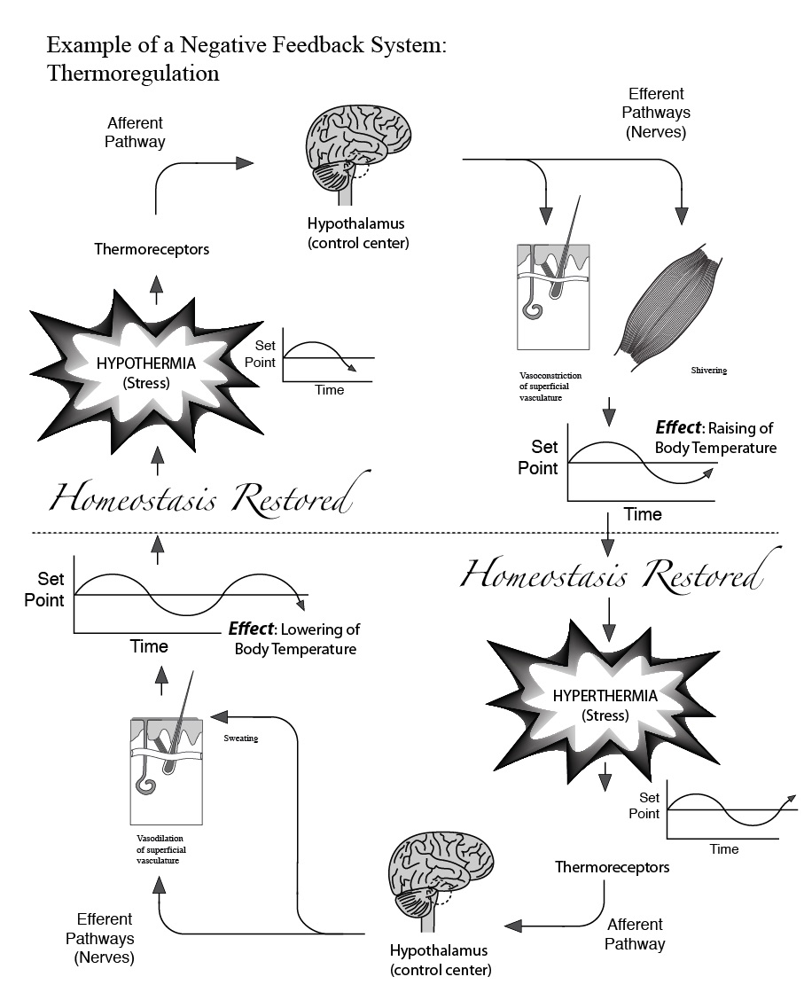

Slide 50
Positive Feedback Mechanisms

Slide 51
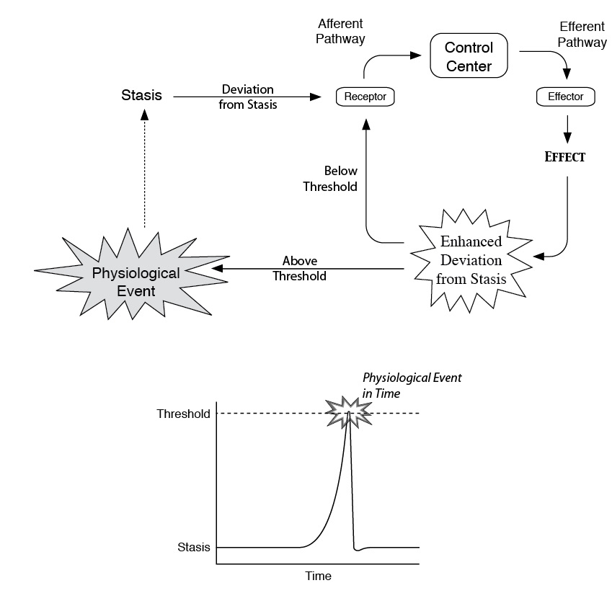

Slide 52
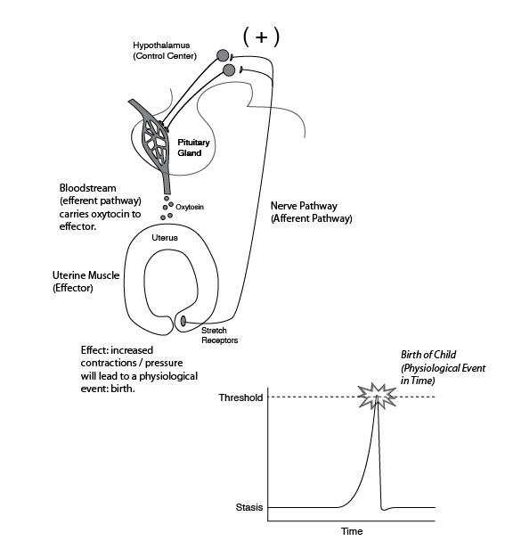

Slide 54
Structural Plan

Slide 55
Regional Anatomy

Slide 60
Superficial vs Deep

Slide 63
Body Cavities

Slide 64
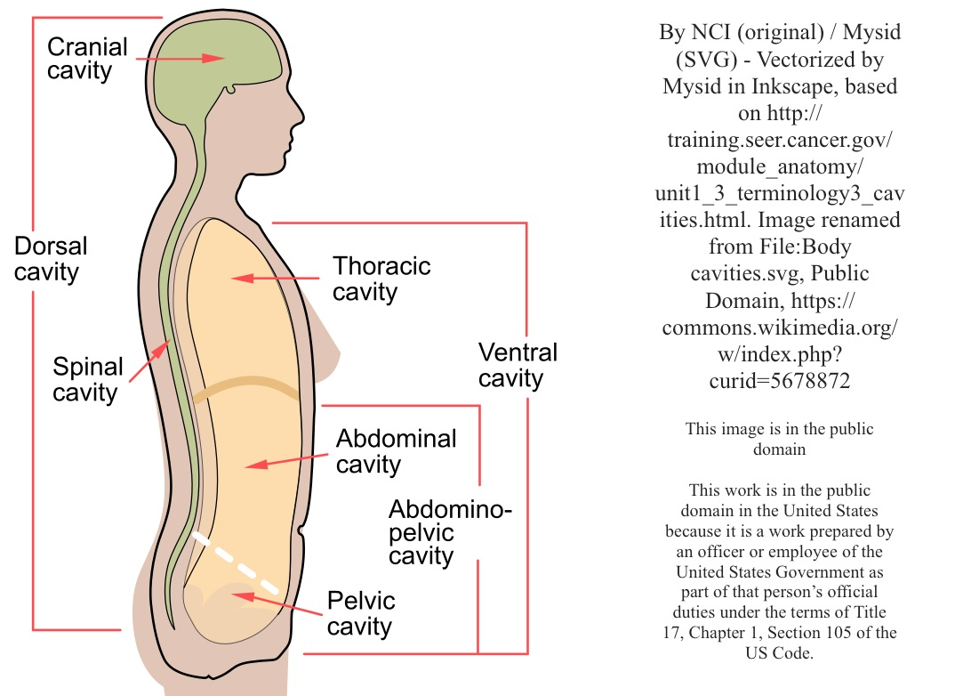

Slide 65
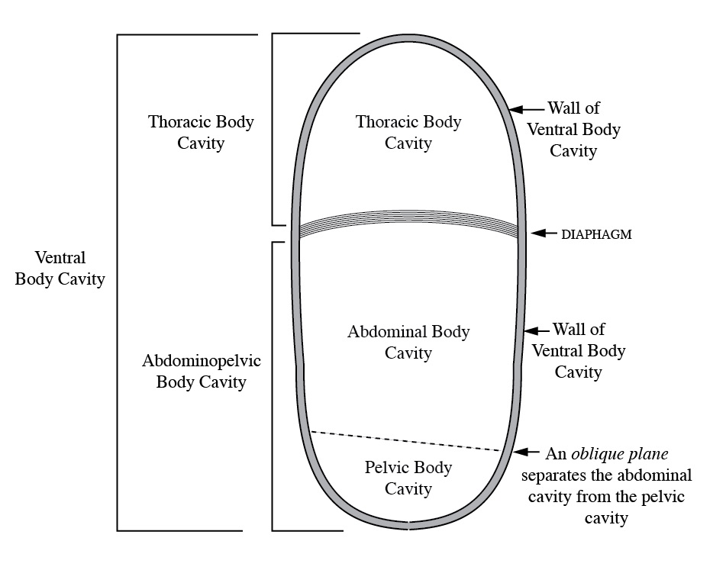

Slide 67
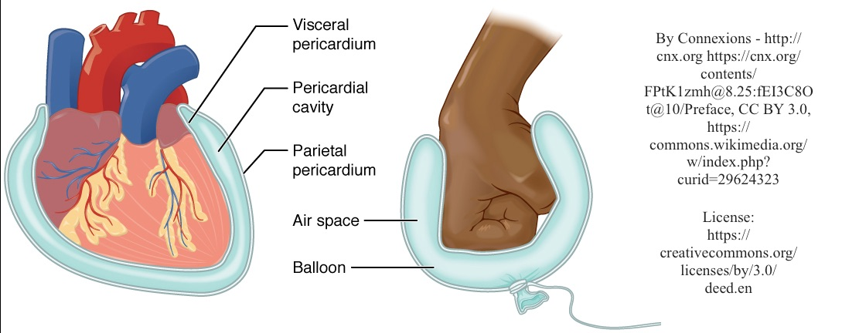

Slide 68
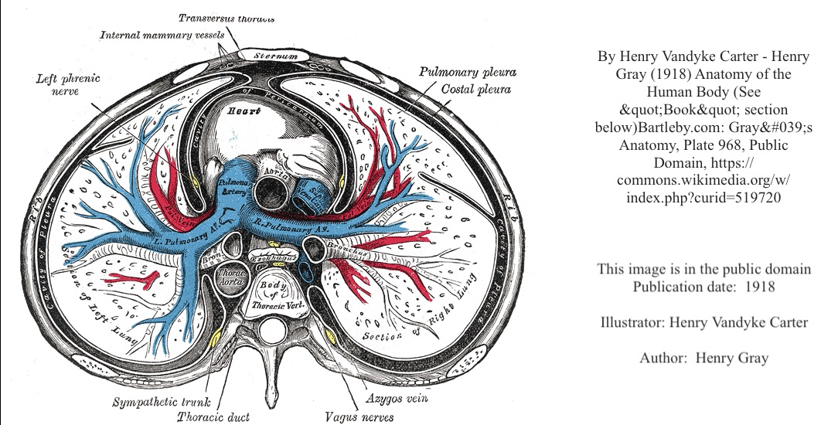

Slide 73
Anatomical Areas:
Regions and Quadrants

